Slide 1
ADS-B
REFLECTIONS ON 2018 INSTALLATIONS

Slide 2
WHAT IS ADS-B?
Automatic Dependent Surveillance - Broadcast
ADS-B is a system in which electronic equipment onboard an aircraft automatically broadcasts the precise location of the aircraft via a digital data link. Other aircraft and ATC can see the aircraft’s position/altitude without the need for radar
ADS-B Operating Frequencies
1090 MHz – associated with current Mode A, C, and S transponders. ADS-B info included within Mode S Extended Squitter (ES) messages
978 MHz – Universal Access Transceivers (UAT). US only
ADS-B Out - Transmission of ADS-B information from an aircraft
ADS-B In - Receipt of ADS-B information by an aircraft
Different equipment required for Out vs In capabilities
FAA 1/1/2020 Mandate addresses ADS-B Out usage
Also
ADS-R – Translation, reformatting, and rebroadcasting information to enable aircraft operating on an alternate frequency to process other aircraft’s information
TIS-B – Broadcast of transponder-based traffic information derived from ATC surveillance systems
FIS-B – UAT only. Advisory aeronautical and weather information

Slide 3
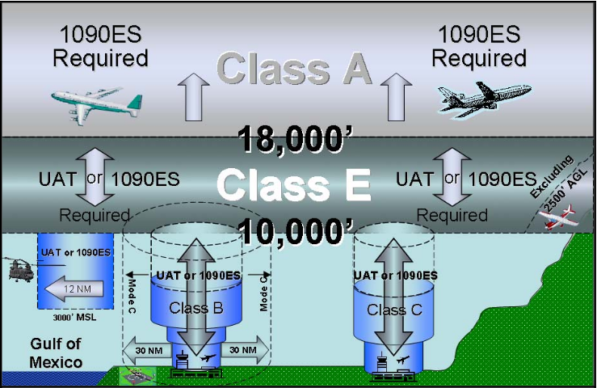
ADS-B Airspace

Slide 4
WHY INSTALL ADS-B OUT?
Gliders are exempt aren’t they?
The regulation 14 CFR 91.225(e) allows aircraft not certificated with an electrical system, including balloons and gliders, not equipped with ADS-B Out to operate within 30 nautical miles of a Class B primary airport—basically, within its Mode C veil—while remaining outside of any Class B or Class C airspace.
These aircraft can operate as high as 17,999 feet msl except above Class B or Class C airspace; they also can operate beneath Class B and Class C airspace.
Operationally the ADS-B Out rules mirror the transponder equipage requirements in 14 CFR 91.215.
Relevant denied airspace without ATC approval
Above Class B & C and less than 10,000’
Spokane/Fairchild AFB 6400’ to 10,000’
“See and avoid”
Is becoming “See, be seen, and avoid”

Slide 5
WHAT TYPE OF ADS-B?
Full compliance – TSO-C166b (or TSO-C154c), 91.227
Source Integrity Level (SIL)=3
Experimental, TT22, TN72, GPS Antenna
Certified, TT22, TN70, TA70 GPS Antenna, w/advisory 337
TABS (Traffic Awareness Beacon System) – TSO-C199
Visible to other aircraft with TAS, TCAS I, TCAS II, and ADS-B IN
SIL=1
TT21, TN72, GPS Antenna
Other
SIL=0
TT?? With GPS via NMEA from PowerFLARM

Slide 6
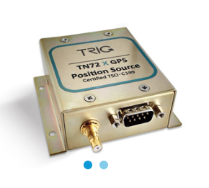
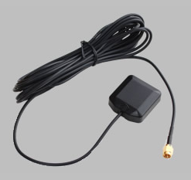
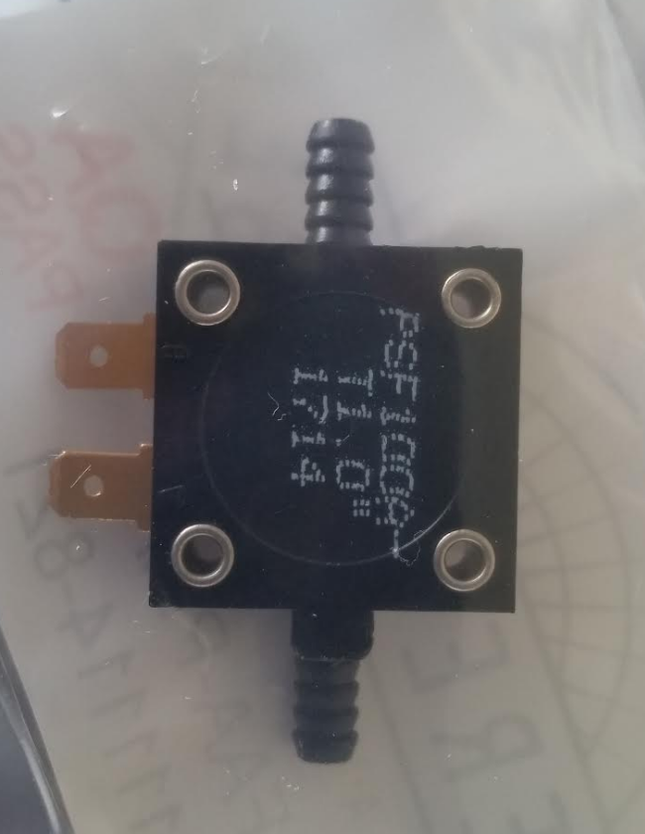
N317KF (Experimental) Installation
Previously installed Trig TT22 Mode S Transponder
Added
Trig TN72 GPS Receiver (~$375)
GPS Active Antenna (~$50)
Peregrine Squat Airspeed Switch Kit (~$125)
w/STC, cheaper as a part for Experimental
Upgraded
Trig TT22 upgraded to the latest software

Slide 7
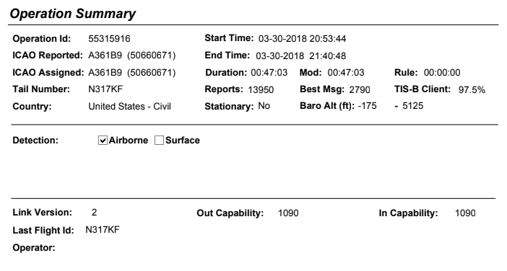
Assessing ADS-B OUT Performance
FAA Public ADS-B Performance Report
https://adsbperformance.faa.gov/paprrequest.aspx (or Google)
Full ADS-B compliance testing only

Slide 8
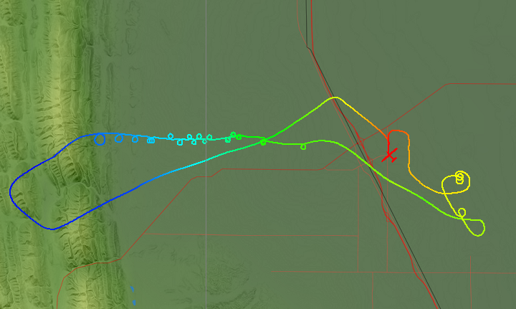
First FLIght
Williams, CA
Comparing SeeYou and FAA
Take off
SeeYou 20:53:11,
FAA 20:53:44 (~50’ AGL)
Landing
SeeYou 21:41:05
FAA 21:40:48
Squat switch changed GND -> ALT mode ~40kts

Slide 9
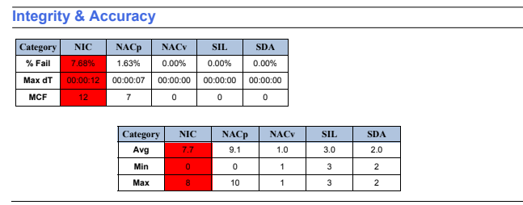

Slide 10
More Acronyms
NIC – Navigation Integrity Category
Radius of containment around the aircraft.
91.227 requires a min NIC of 7 (<370m)
SIL – Source Integrity Level
Measure of the probability of not being within the containment radius without indication
91.277 requires a value of 3 (prob exceeding NIC < 1 x 10⁻⁷ / flight hour)
NACp – Navigation Accuracy Category for Position
Accuracy of the aircraft position being transmitted
91.277 requires a min NACp of 8 (95% Horz accuracy bounds < 92.6m)
NACv – Navigation Accuracy Category for Velocity
1 = < 10 m/s
SDA – System Design Assurance
Likelihood of bad data being sent
Pass values of 2 or 3 (prob false/misleading info < 1 x 10⁻⁵ / flight hour)

Slide 11
Resolving Performance Issues
Working hypothesis was that the GPS wasn’t getting an accurate enough fix
Placement of GPS Antenna variations
Original location deep in instrument bay on one side
% Failure rate : NIC = 7.68% (FAIL), NACp = 1.63% (pass), other 0.0%
High banked turns causing too much other equipment to get in the way?
Second attempt (3/31)
GPS Antenna relocated high and central
Level flight, all other GPS antennas disconnected during short flight
% Failure rate : NIC = 59.07% (FAIL), NACp = 12.46% (FAIL), other 0.0%
Too close to active FLARM antenna

Slide 12
Resolving Performance Issues
Placement of GPS Antenna (cont.)
Third attempt (4/1)
FLARM off, all other systems on, short level flight
% Failure rate : 0.0% on all metrics – Complete PASS
Fourth attempt (4/2)
As above but normal gliding maneuvers
% Failure rate : NIC = 1.19% (pass), NACp = 0.12% (pass), other 0.0%
Fifth attempt (4/22)
Relocated GPS Antenna onto canopy ledge by right elbow
Loooong connecting cable
All equipment turned on, normal gliding maneuvers
% Failure rate : 0.0% on all metrics – Complete PASS
Could have done attempts 1 thru 4 on the same day but wasn’t certain how to drive the FAA website
Have checked six other flights since – still getting pass marks

Slide 13
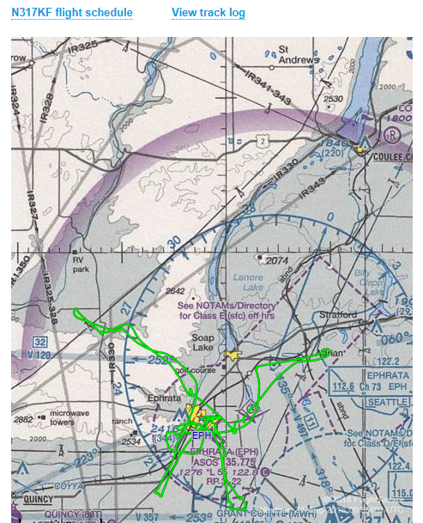
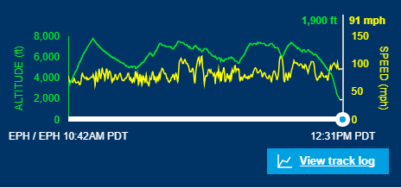
“Be seen”
Numerous reports of being able to be seen for miles
Flightaware ADS-B tracking in real-time
https://flightaware.com/live/flight/N317KF

Slide 14
Still getting “close encounters”
Boeing 787 Flight Test 5/13
Above Ephrata township
787 was descending, I was climbing. Past within ¼ mile and 1000’ vertical separation
Flight Nav computer had zoomed in while thermalling (so no PowerFLARM derived ADS-B situational awareness)
No ADS-B IN display
BAe 146 Fire fighting air tankers
Above Mackay, ID below cloudbase
Transitioning Ephrata/Grant County
No electronic position transmission
Mark I eye-ball

Slide 15
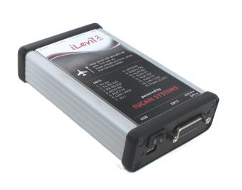
So what’s next? - ADS-B IN
iLevil AW 2
Dual band (1090/978 MHz) receiver
ADS-B, ADS-R, TIS-B, FIS-B, AHRS, RS-232
Outputs GDL-90 and proprietary messages via WiFi
3rd Party Apps (typically running on Tablets)
ForeFlight, Xavion, Naviator, Sky-Map, etc
Or home-grown application
Emphasis on collision avoidance not merely situational awareness that requires constant monitoring
And you thought FLARM leaching was bad…

Slide 16
QUESTIONS?

